Slide 1
Assignment No:1 Mini Research about Business Intelligence & Data Warehouse Key concepts
Submitted by : Basavraj Jaliminche (8800149)

Slide 2
What is business intelligence as a concept ?
To help firms make more data-driven decisions, business intelligence (BI) includes business analytics, data mining, data visualisation, data tools and infrastructure, and best practises. In practise, you've got modern business intelligence when you have a holistic perspective of your company's data and can utilise it to drive change, eliminate inefficiencies, and quickly adjust to market or supplier changes.

Slide 3
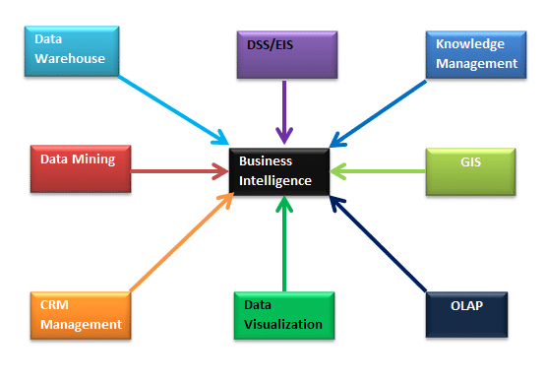
What is the definition of a business intelligence system?
Definition : Business intelligence is the process by which enterprises use strategies and technologies for analysing current and historical data, with the objective of improving strategic decision-making and providing a competitive advantage.

Slide 4
Briefly describe the key components in generic Business Intelligence system?
The main components of business intelligence are
Data Sources and staging
Data Warehouse
Extract, Transform and Load
Semantic Layer
Data Visualization
1. Data Sources and Staging:
The data created by the business tools is stored in a variety of ways utilising various technologies. We usually have multiple data sources contributing to the data analysis in real-world scenarios. To be able to analyse all the data sources, we require a mechanism to load the data into a central repository. The main reason for that is the business tools required to constantly store data in the underlying storage. Therefore, frequent connections to the source systems can put our production systems at risk of being unresponsive or performing poorly. The central repository where we store the data from various data sources is called Staging.

Slide 5
2. Data Warehouse :
Data warehouse are a subset of data warehouses, businesses can utilise them to give people access to data that they wouldn't have otherwise. Smaller and more professionally constructed data marts result in lower storage costs and faster analysis .
3. Extract, Transform and Load :
ETL stands for Extract, Transform, and Load.
4. Semantic Layer :
For data analysis and reporting, the semantic layer is employed to create a more efficient and performant environment.
5. Data Visualization:
Using various reporting or data visualisation methods, data visualisation refers to expressing data from the semantic layer with graphical diagrams and charts.

Slide 6
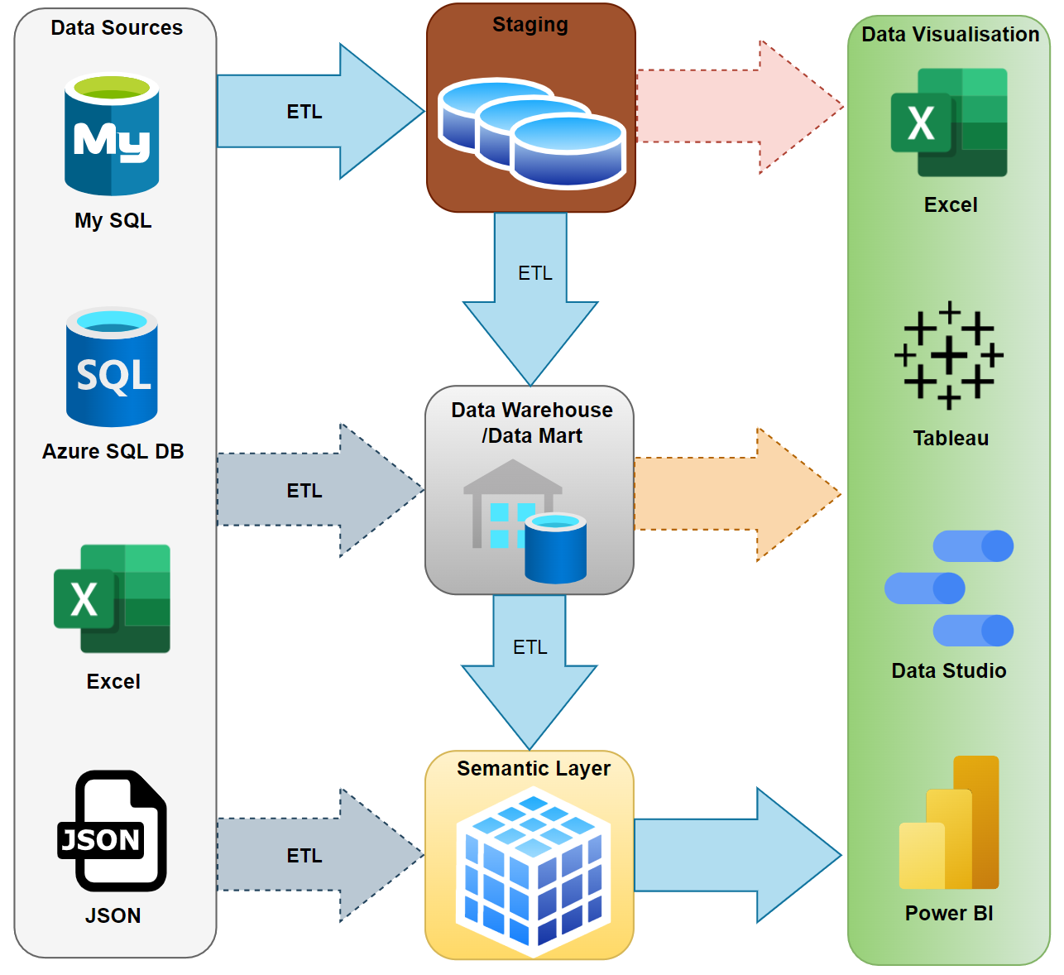
Graphical Representation of Business Intelligance System

Slide 7
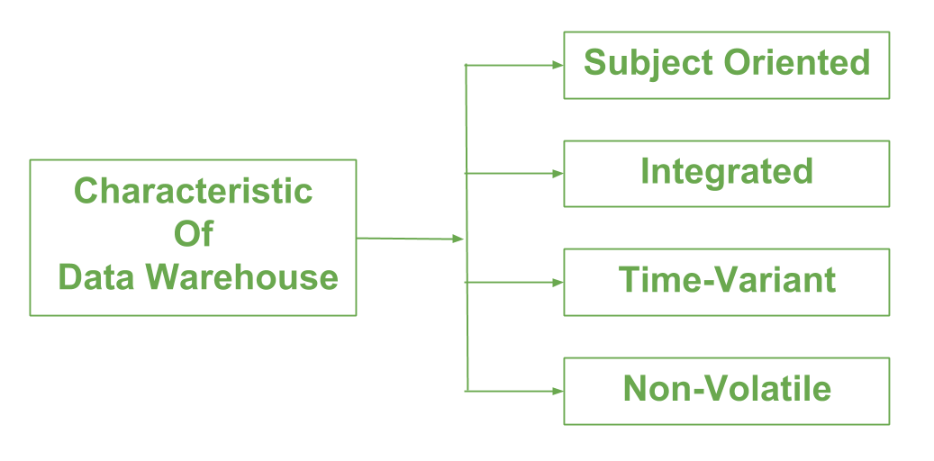
Describe the key features of data warehouse?

Slide 8
1.Subject Oriented:
A data warehouse is always a subject oriented as it delivers information about a theme instead of organization’s current operations. It can be achieved on specific theme. That means the data warehousing process is proposed to handle with a specific theme which is more defined. These themes can be sales, distributions, marketing etc. A data warehouse never put emphasis only current operations. Instead, it focuses on demonstrating and analysis of data to make various decision.
2. Integrated:
Integration means founding a shared entity to scale the all similar data from the different databases. The data also required to be resided into various data warehouse in shared and generally granted manner.A data warehouse is built by integrating data from various sources of data such that a mainframe and a relational database. In addition, it must have reliable naming conventions, format and codes. Integration of data warehouse benefits in effective analysis of data. Reliability in naming conventions, column scaling, encoding structure etc. should be confirmed. Integration of data warehouse handles various subject related warehouse.

Slide 9
3. Time-Variant
In this data is maintained via different intervals of time such as weekly, monthly, or annually etc. It founds various time limit which are structured between the large datasets and are held in online transaction process (OLTP). The time limits for data warehouse is wide-ranged than that of operational systems. The data resided in data warehouse is predictable with a specific interval of time and delivers information from the historical perspective. It comprises elements of time explicitly or implicitly. Another feature of time-variance is that once data is stored in the data warehouse then it cannot be modified, alter, or updated.
4. Non-Volatile
Data is not erased or deleted when new data is inserted. It includes the mammoth quantity of data that is inserted into modification between the selected quantity on logical business. It evaluates the analysis within the technologies of warehouse. In this, data is read-only and refreshed at particular intervals. This is beneficial in analysing historical data and in comprehension the functionality.

Slide 10
Based on your readings, How we measure success in implementing a Business Intelligence solution?
According to Erickson group success implementation of Business Intelligence solution
1. Usage tracking
2. Surveys
3. Social media analysis.
4. Spreadmarts
5. Cost efficiencies.
6. Strategy
7. user satisfaction
8. Service quality
9.Benifits

Slide 11
References
https://www.investopedia.com/terms/b/business-intelligence-bi.asp
https://www.heavy.ai/technical-glossary/business-intelligence
https://biinsight.com/business-intelligence-components-and-how-they-relate-to-power-bi/
https://www.geeksforgeeks.org/characteristics-and-functions-of-data-warehouse/
https://www.eckerson.com/articles/how-to-measure-bi-success

